Slide 1
Student Digital Portfolio.
Name: Noorul Farhana A
Register No & NMID: 24134131802522013 & asanm41341324214012
Department: B.Sc Computer Science
College/University: Deen college of arts and science/Annamalai University

Slide 2
PROJECT TITLE
Student Portfolio Website (HTML, CSS, JS)

Slide 3


AGENDA
Problem Statement
Project Overview
End Users
Tools and Technologies
Portfolio design and Layout
Features and Functionality
Results and Screenshots
Conclusion
Github Link
3/21/2024 Annual Review

Slide 4

PROBLEM STATEMENT
• Students often lack a centralized and professional portfolio platform to showcase their skills, projects, and achievements.
• Traditional resumes are static and do not highlight practical skills effectively.
• There is a need for an interactive digital portfolio.

Slide 5

PROJECT OVERVIEW
The project is a personal portfolio website developed using HTML, CSS, and JavaScript.
It provides a platform for students to:
• Showcase their skills, projects, and achievements
• Present academic and personal details
• Share GitHub repositories and contact information

Slide 6

WHO ARE THE END USERS?
• Students – to display academic and project work
• Recruiters/Employers – to evaluate skills and projects
• Teachers/Institutions – to track student achievements
• Peers/Community – to collaborate and connect

Slide 7

TOOLS AND TECHNIQUES
• Frontend: HTML, CSS, JavaScript
• Design Tools: Canva / Figma (for UI design)
• Version Control: Git & GitHub
• Browser: Google Chrome / Edge

Slide 8
POTFOLIO DESIGN AND LAYOUT
• Homepage – Introduction & navigation
• About Me – Personal & academic background
• Projects – List with descriptions/screenshots
• Skills – Technical and soft skills
• Contact Page – Email & social links
‹#›

Slide 9
FEATURES AND FUNCTIONALITY
• Responsive design (works on mobile & desktop)
• Interactive navigation menu
• Project showcase with screenshots
• Contact form integration
• GitHub link for source code

Slide 10
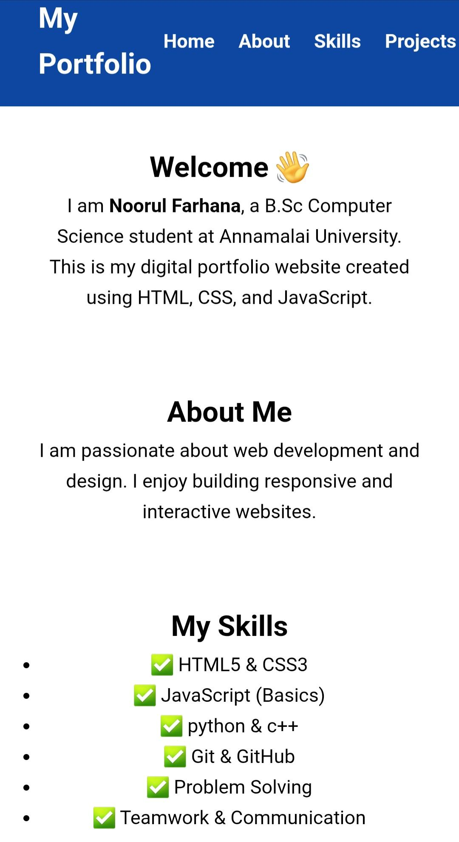
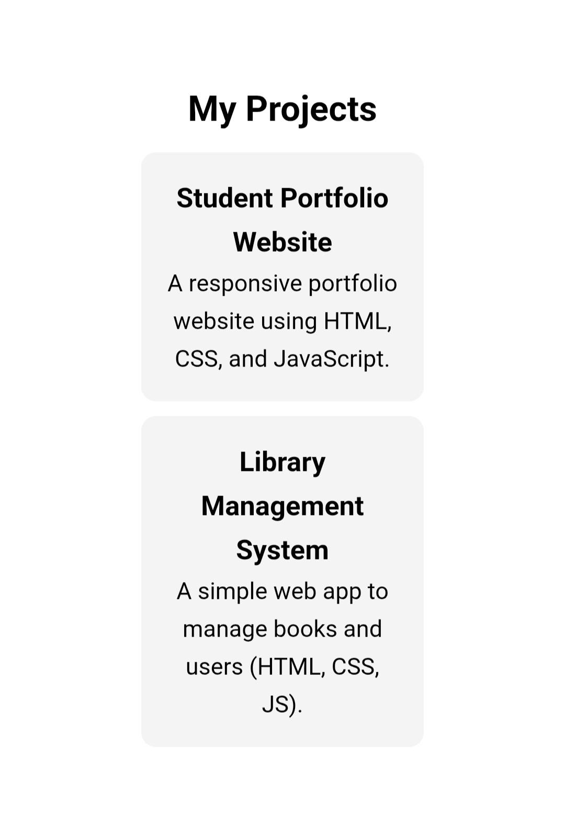
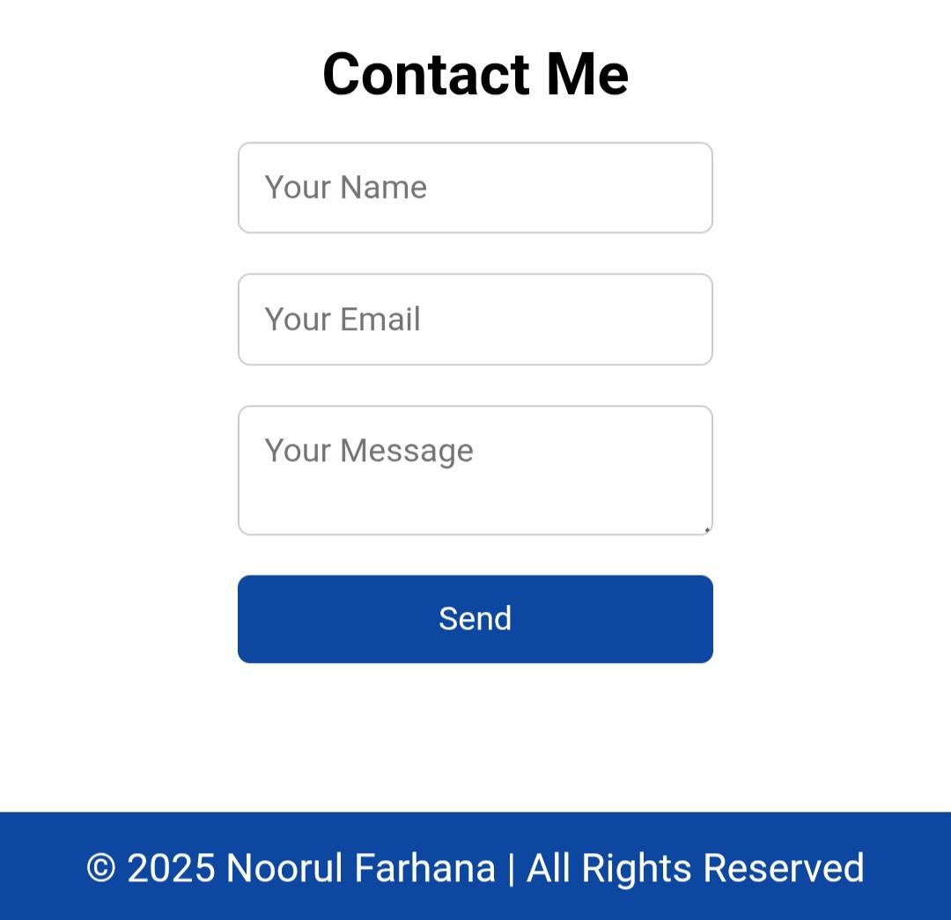

RESULTS AND SCREENSHOTS
3/21/2024 Annual Review
‹#›

Slide 11
CONCLUSION
• Created a professional digital portfolio website
• Demonstrated skills in HTML, CSS, and JavaScript
• Improved personal branding & employability
• Can be enhanced with backend (PHP/Node.js) & database integration in the future
‹#›

Slide 12
GITHUB LINK
https://github.com/dccs24farhana-noorul/Farhananoorul-TNSDC-FWD-DP.git

